Slide 1


Slide 2


Slide 3


Slide 4
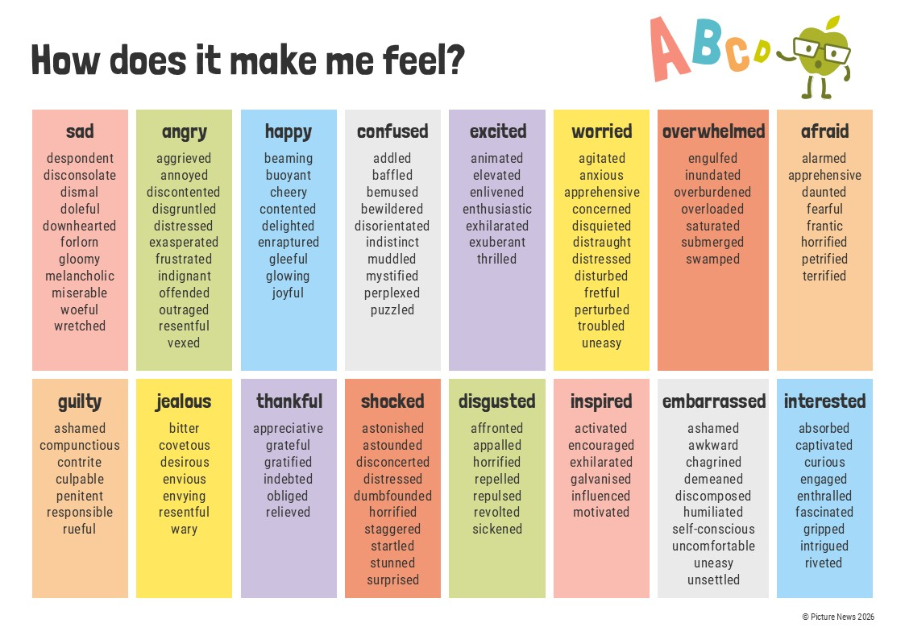

Slide 5


Slide 6
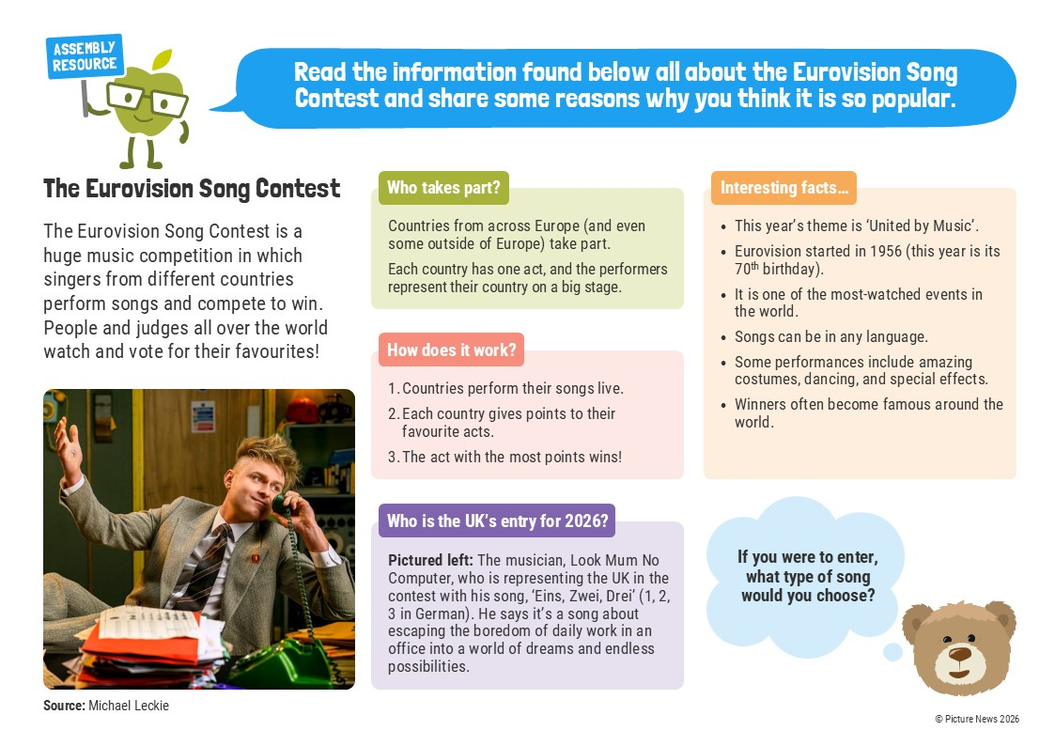

Slide 7
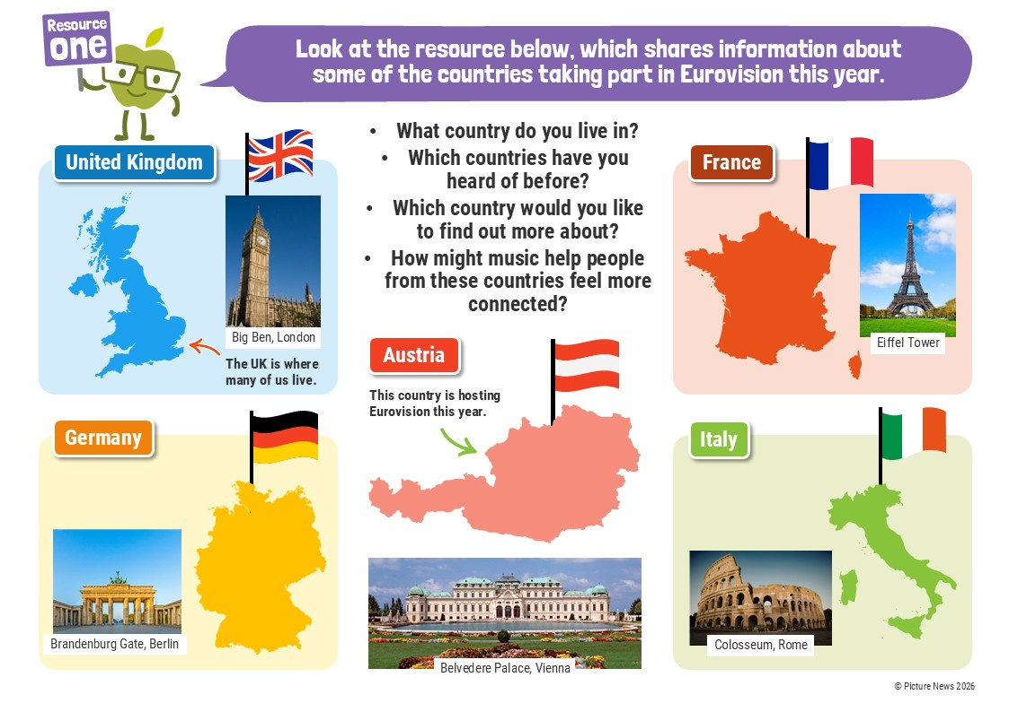

Slide 8
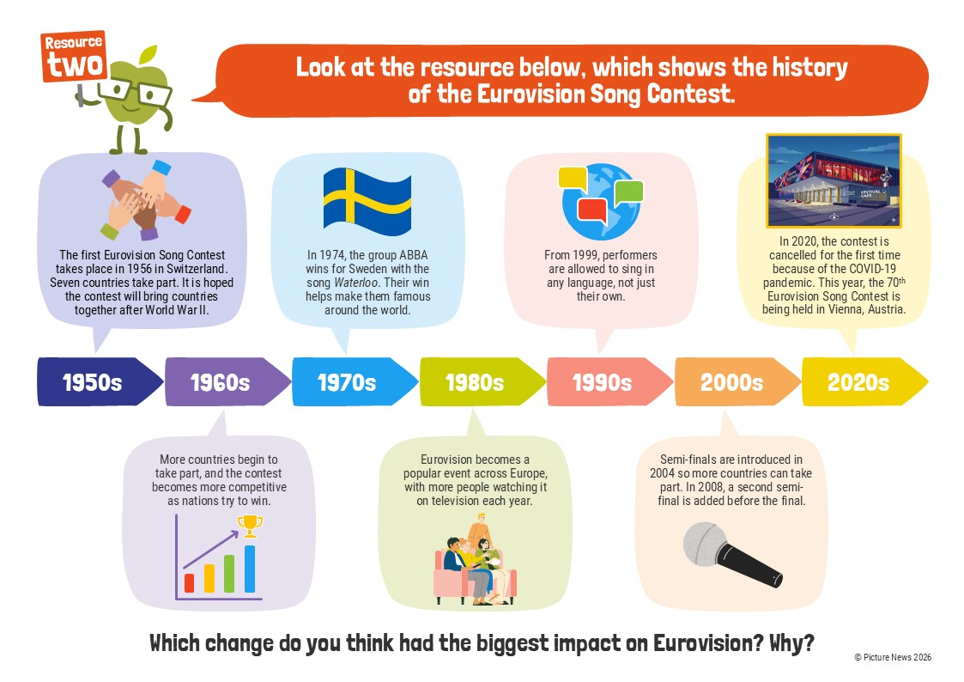

Slide 10


Slide 11
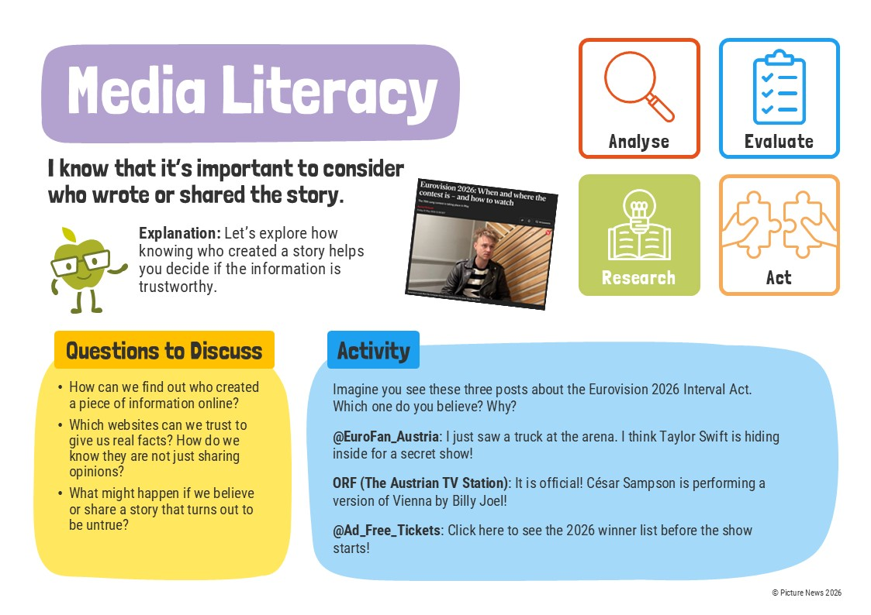

Slide 12


Slide 13


Slide 14


Slide 15
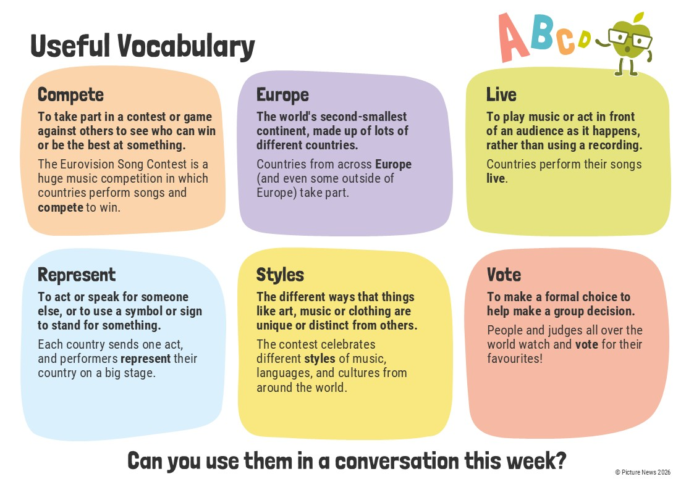

Slide 16
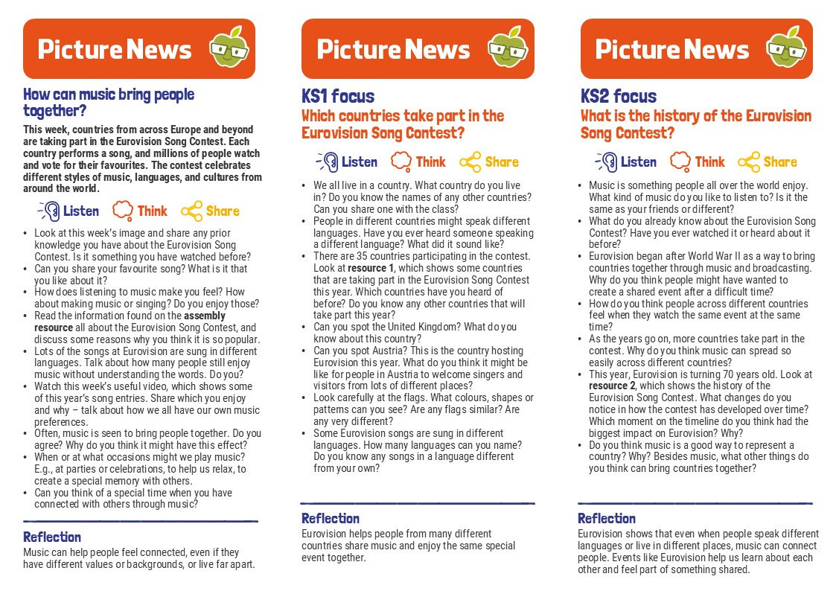

Slide 17
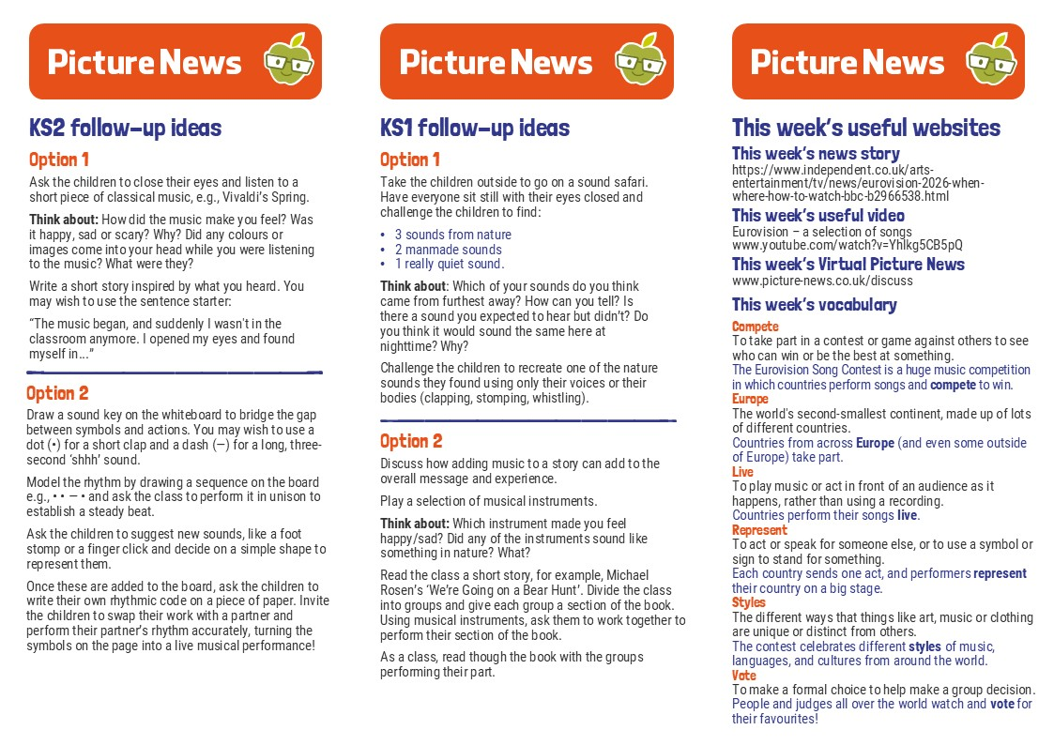

Slide 18



Slide 19

picture-news.co.uk/discuss
help@picture-news.co.uk
/picturenewsprimary/

Slide 20
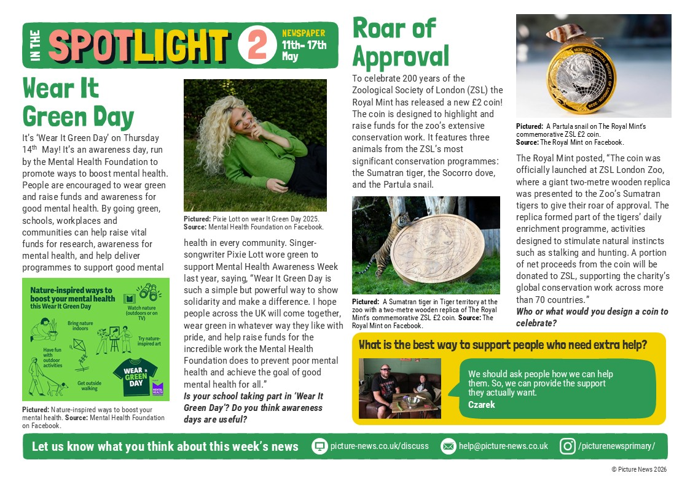
picture-news.co.uk/discuss
help@picture-news.co.uk
/picturenewsprimary/

